Slide 1
White Box Testing

Slide 2
White Box Design
Called glass-box testing also.
Uses the control structure of the procedural design to derive test cases.
Using white-box testing we can derive test cases that
  guarantee that all independent paths within a module have been exercised at least once,
  exercise all logical decisions on their true and false sides,
  execute all loops at their boundaries and within their operational bounds,
  and exercise internal data structures to ensure their validity.

Slide 3
White Box Design
"Why spend time and energy worrying about (and testing) logics when we might better expend effort ensuring that program requirements have been met?“
OR
Why don't we spend all of our energy on black-box tests?

Slide 4
White Box Design
The answer lies in the nature of software defects:
  Logic errors and incorrect assumptions are inversely proportional to the probability that a program path will be executed
  We often believe that a logical path is not likely to be executed when, in fact, it may be executed on a regular basis.
  Typographical errors are random
Each of these reasons provides an argument for conducting white-box tests.

Slide 5
White-Box Testing
Statement coverage
Branch coverage
Path coverage
Condition coverage
Basis Path Testing
Mutation testing

Slide 6
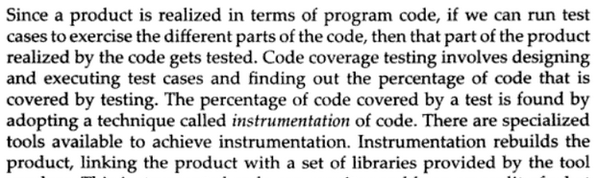
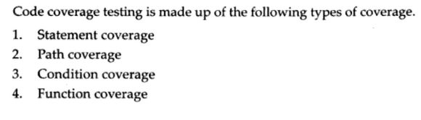
Code Coverage Testing

Slide 7
Statement coverage
Programs constructs can be usually classified as:
1. Sequential control flow
2. Two way decision statements (if then else)
3. Multi way decision statements (switch)
4. Loops (while, do, repeat until, for)

Slide 8
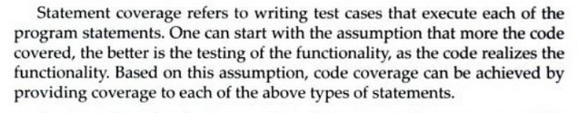
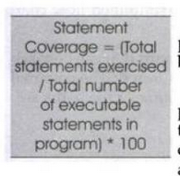

Slide 9
A good percentage of defects comes because of loops that do not function properly.
Most often loops fail in what are called as boundary conditions.
One of the most common looping error is that termination condition of loop is not properly stated.
For better statement coverage for statements within loop there should be test cases that:
1. Skip the loop completely.
2. Exercise the loop between once and maximum no. of times.
3. Try covering loop around the boundary.
Exhaustive coverage of all statements in a program will be practically impossible.

Slide 10
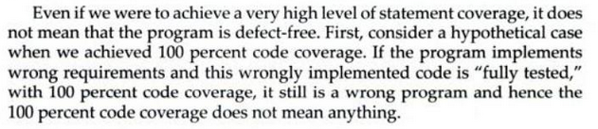
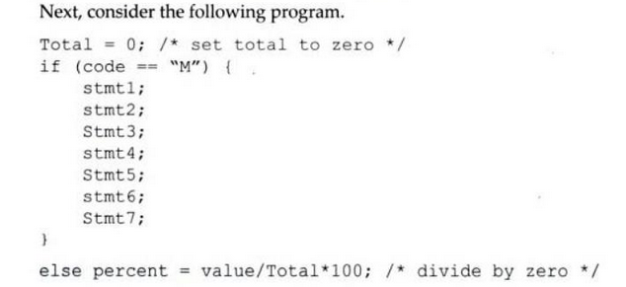

Slide 11

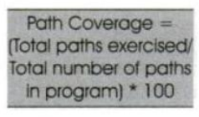
Path Coverage

Slide 12
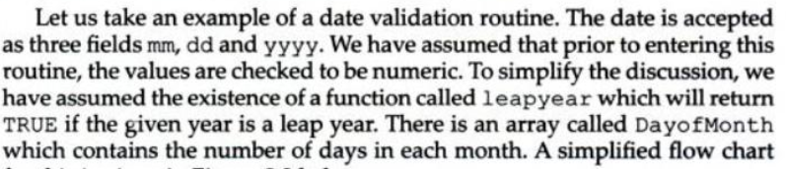

Slide 13
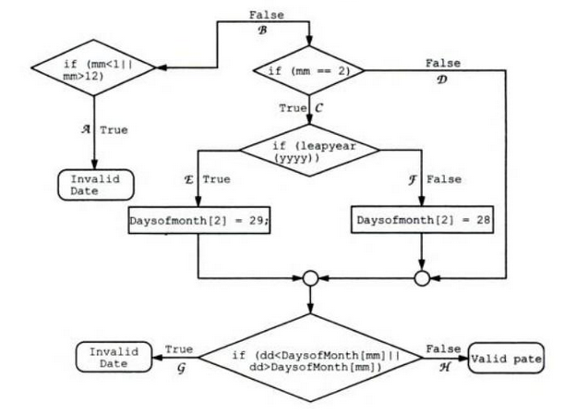

Slide 14



Slide 15
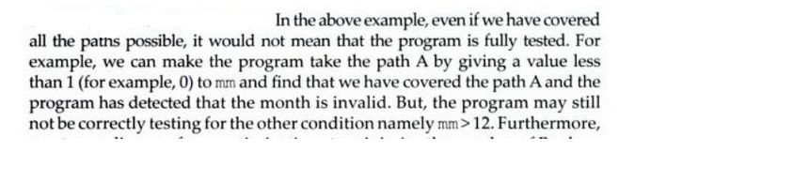
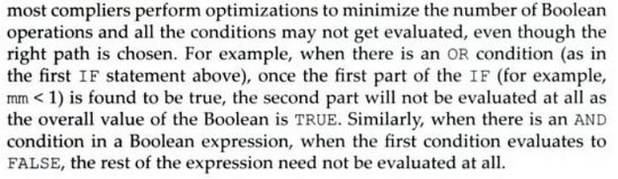
Condition Coverage

Slide 16
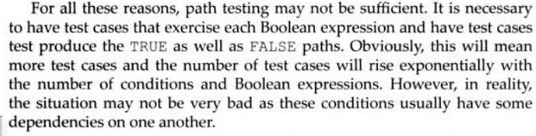
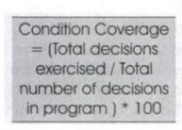

Slide 17
Control flow graph (CFG)
A control flow graph (CFG) describes:
  the sequence in which different instructions of a program get executed.
  the way control flows through the program.
  How to draw Control flow graph?
Number all the statements of a program.
Numbered statements:
  represent nodes of the control flow graph.
An edge from one node to another node exists:
  if execution of the statement representing the first node can result in transfer of control to the other node.

Slide 18
Example
int f1(int x,int y){
while (x != y){
if (x>y) then
x=x-y;
else y=y-x;
}
return x; }
1
2
3
4
5
6

Slide 19
BASIS PATH TESTING
The basis path method enables the test case designer to derive a logical complexity measure of a procedural design and use this measure as a guide for defining a basis set of execution paths.
Test cases derived to exercise the basis set are guaranteed to execute every statement in the program at least one time during testing.

Slide 20
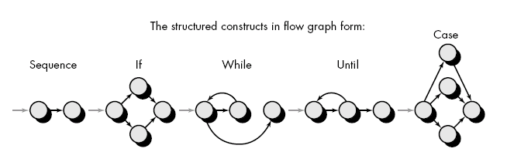
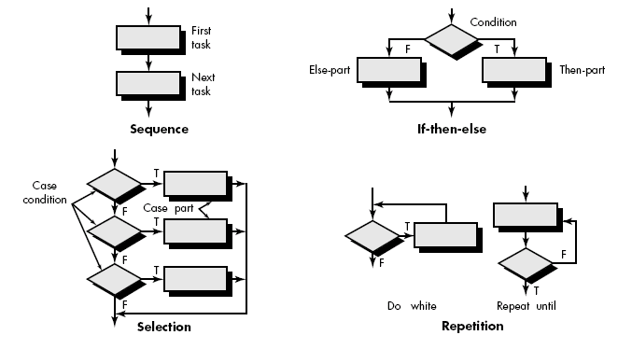
Flow Graph Notation
Start with simple notation for the representation of control flow (called flow graph). It represent logical control flow.

Slide 21
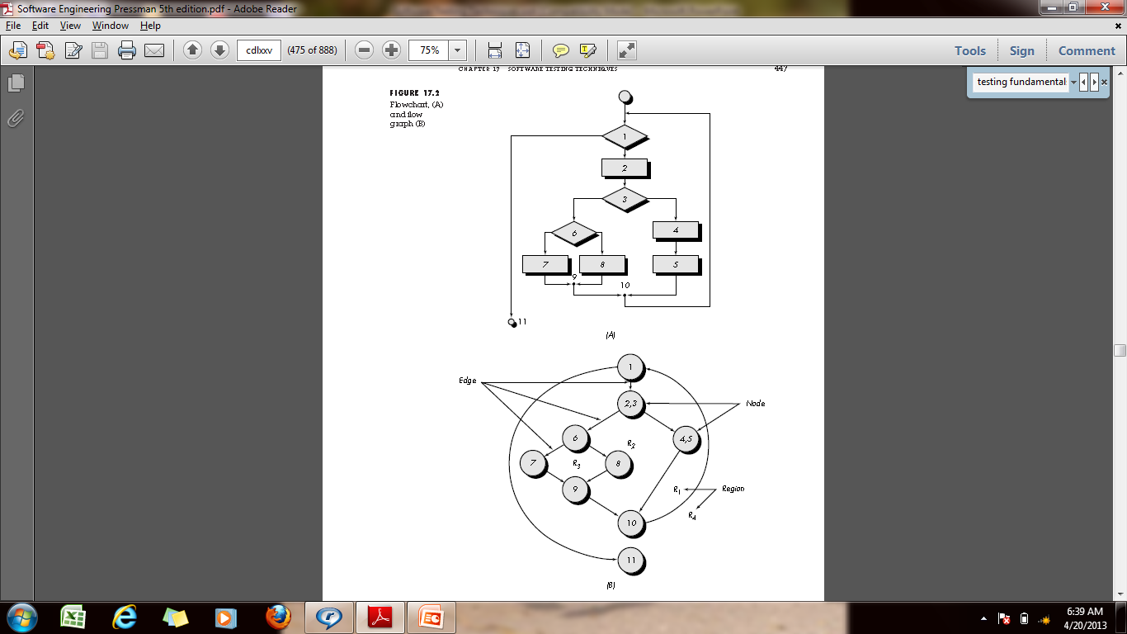

Slide 22
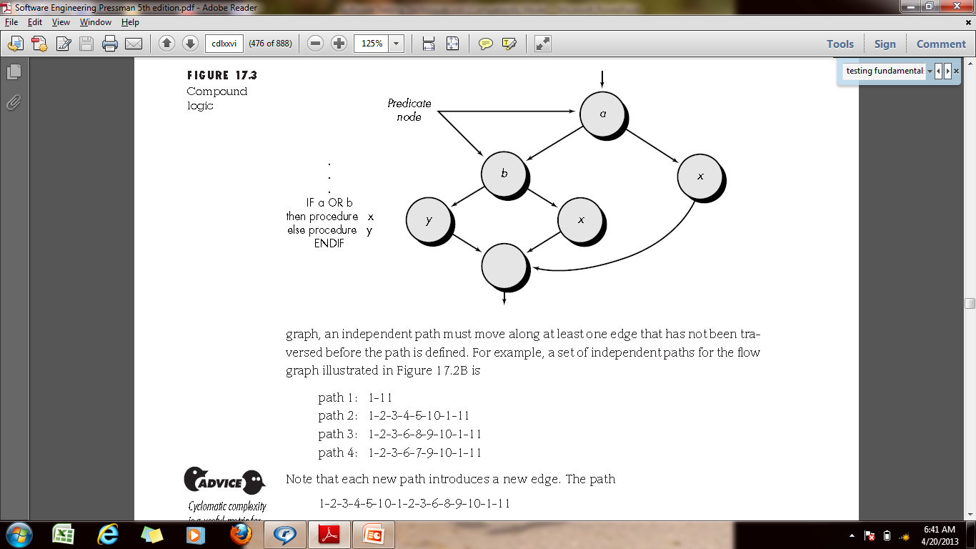

Slide 23
Cyclomatic Complexity
Cyclomatic complexity is a software metric that provides a quantitative measure of the logical complexity of a program.
When used in the context of the basis path testing method, the value computed defines
  the number of independent paths
  and provides us with an upper bound for the number of tests

Slide 24
Cyclomatic Complexity
An independent path is any path through the program that introduces at least one new set of processing statements or a new condition.
e.g.
path 1: 1-11
path 2: 1-2-3-4-5-10-1-11
path 3: 1-2-3-6-8-9-10-1-11
path 4: 1-2-3-6-7-9-10-1-11
Paths 1, 2, 3, and 4 constitute a basis set for the flow graph.
How do we know how many paths to look for? The computation of cyclomatic complexity provides the answer.

Slide 25
Cyclomatic Complexity
Complexity is computed in one of three ways:
  The number of regions of the flow graph correspond to the cyclomatic complexity.
  Cyclomatic complexity, V(G), for a flow graph, G, is defined as V(G) = E -N + 2
where E is the number of flow graph edges, N is the number of flow graph nodes.
  3. Cyclomatic complexity, V(G), for a flow graph, G, is also defined as
  V(G) = P + 1
  where P is the number of predicate nodes contained in the flow graph G.

Slide 26
Mutation Testing
The software is first tested:
  using an initial testing method based on white-box strategies we already discussed.
After the initial testing is complete,
  mutation testing is taken up.
The idea behind mutation testing:
  make a few arbitrary small changes to a program at a time.

Slide 27
Mutation Testing
Each time the program is changed,
  it is called a mutated program
  the change is called a mutant.
A mutated program:
  tested against the full test suite of the program.
If there exists at least one test case in the test suite for which:
  a mutant gives an incorrect result, then the mutant is said to be dead.
If a mutant remains alive:
  even after all test cases have been exhausted, the test suite is enhanced to kill the mutant.

Slide 28
Mutation Testing
The process of generation and killing of mutants:
  can be automated by predefining a set of primitive changes that can be applied to the program.
The primitive changes can be:
  altering an arithmetic operator,
  changing the value of a constant,
  changing a data type, etc.
A major disadvantage of mutation testing:
  computationally very expensive,
  a large number of possible mutants can be generated.

